Slide 1

Welcome to Amazon Web Services

Slide 2
Creating an AWS account
Pre-Requisites for Start using AWS
1. A telephone number to validate your identity
2. A credit/Debit card to pay your bills
AWS provide us 12 month free tier account

Slide 3
Signing up
The sign-up process consists of five steps:
1 Provide your login credentials.
2 Provide your contact information.
3 Provide your payment details.
4 Verify your identity.
5 Choose your support plan.
Point your favorite web browser to https://aws.amazon.com, and click the Create a Free
Account button.

Slide 4
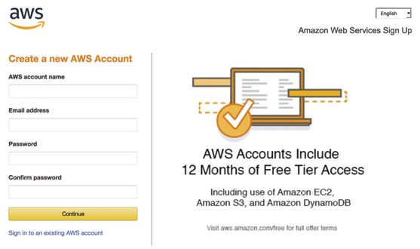
1. PROVIDING YOUR LOGIN CREDENTIALS
Define a name for your AWS account
(for example, aws-in-action-<YOUR-NAME>).
Enter your email address
which acts as the username
for the root user.
Specify a secure password
consisting of at least
20 characters.

Slide 5
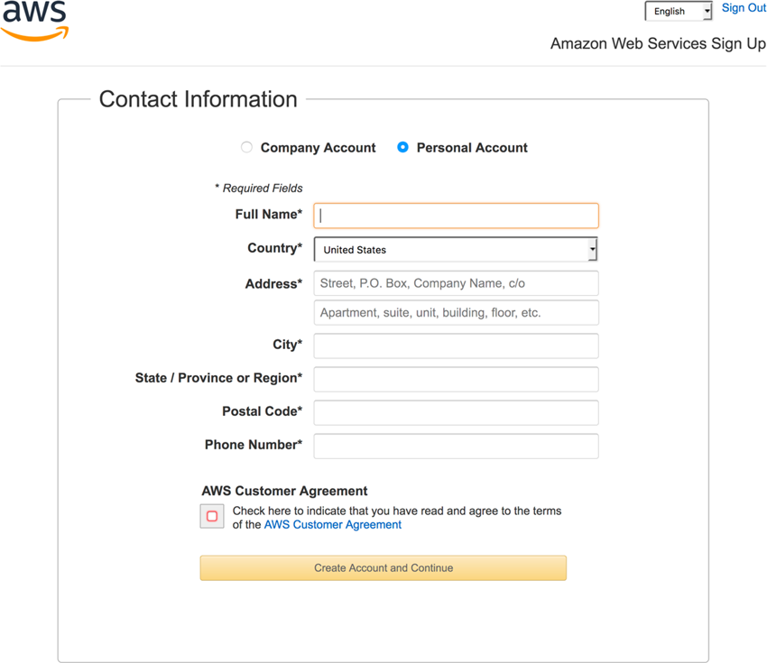
2. PROVIDING YOUR CONTACT INFORMATION

Slide 6
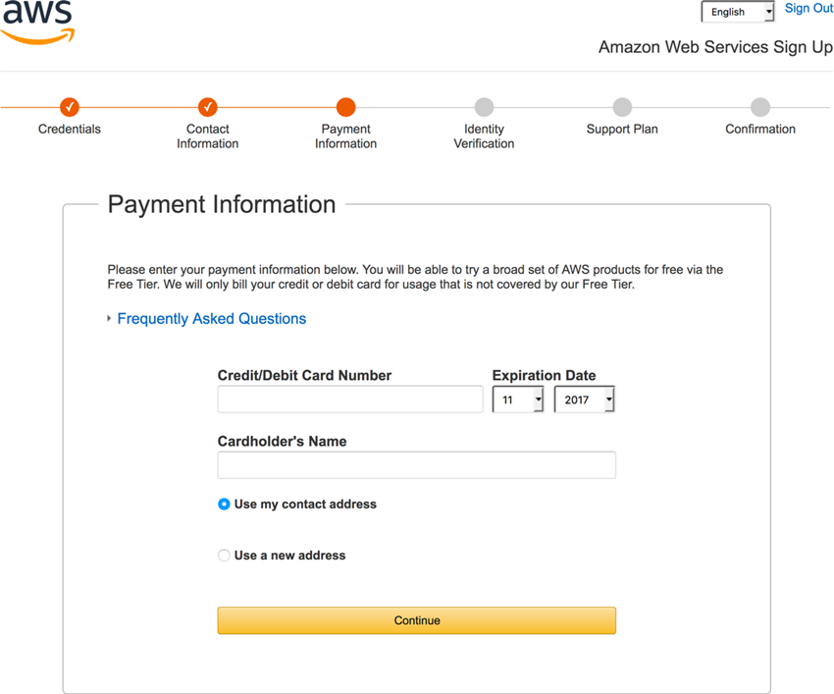
3. PROVIDING YOUR PAYMENT DETAILS

Slide 7
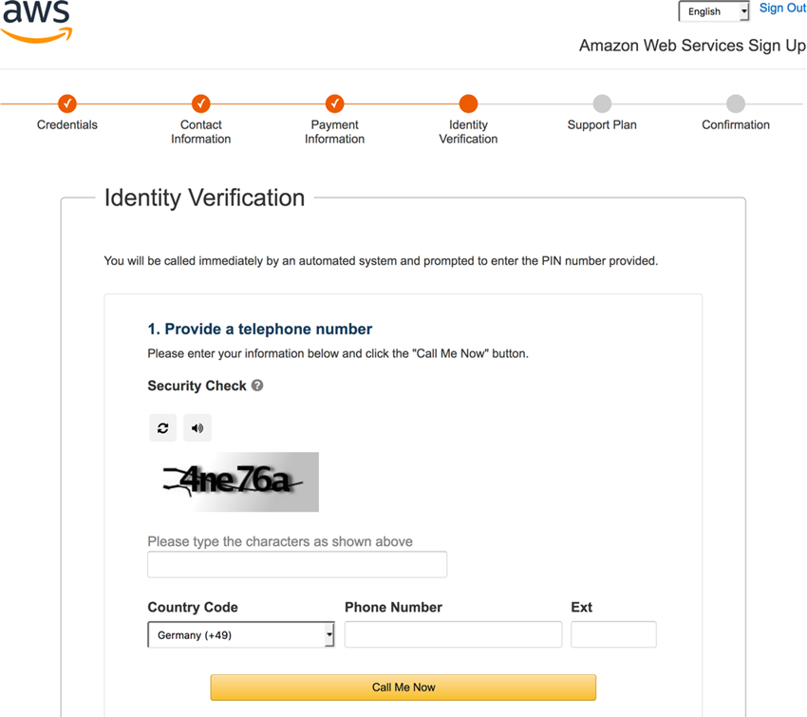
4. VERIFYING YOUR IDENTITY

Slide 8
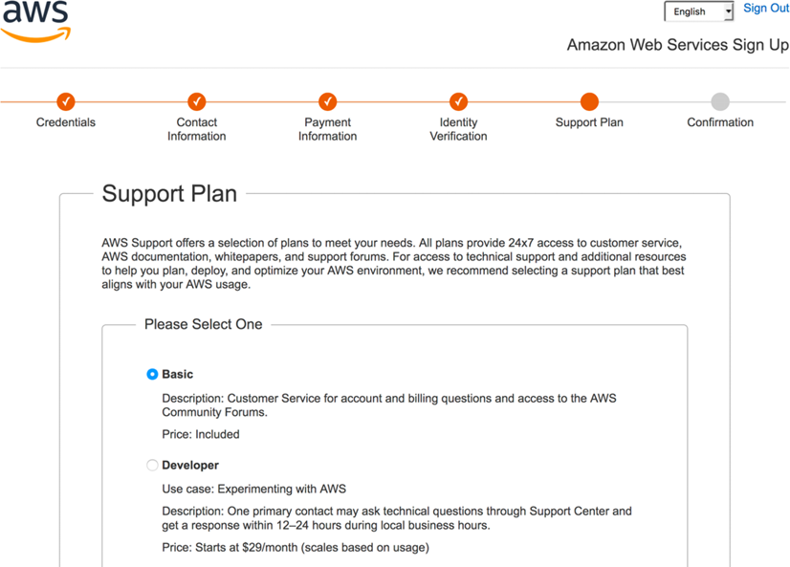
5. CHOOSING YOUR SUPPORT PLAN

Slide 9
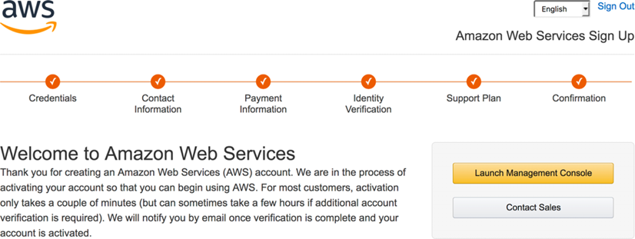
Welcome to Amazon Web Services (Aws)

